Slide 1
Bayesian Filterings for Location Estimation
CSCE 582
Chao Chen
University of South Carolina

Slide 2
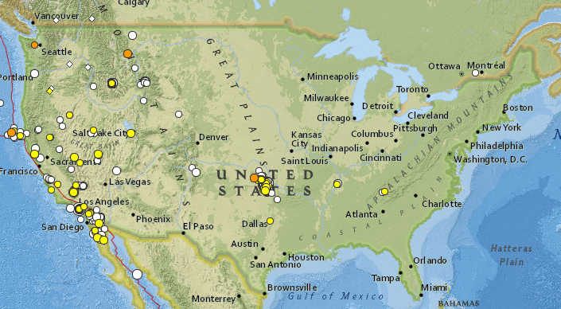

Introduction
Earthquake
Earthquakes in the past 30 days in the 48 conterminous states, Magnitude 2.5+ -Source: USGS earthquake
Twitter
an online social networking and microblogging service
short 140-character text messages
Notes:
An earthquake is the result of a sudden release of energy in the Earth's crust
that creates seismic waves.
Magnitude is an instrumental measure of the amplitude of ground shaking.
Fortunately, large earthquakes are less frequent that small earthquakes. The temporal distribution of earthquakes by size follows a logarithmic rule. As a rule of thumb, for each magnitude unit increase, there are 10 times less earthquakes during a specified time interval. For example there are about 20 major earthquakes each year but only one or two great earthquakes.

Slide 3

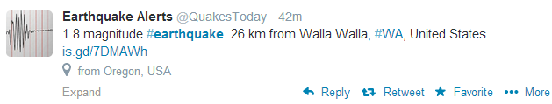


Search Earthquake

Slide 4
Event Detection
Events
Large scale
Influence people’s life
Have both spatial and temporal regions
e.g. Sports events, accidents, storms, hurricanes, and earthquakes
Detection Features:
The number of words in a tweet message, and the position of the query word within a tweet
The words in a tweet
The words before and after the query word
Notes:
Classify each tweet into positive or negative class using SVM.

Slide 5
Twitter User as a Sensor
Assumption 2.1
Each Twitter user is regarded as sensor. A sensor detects a target event and makes a report probabilistically.
Noisier than physical sensors
More than 645 million
Assumption 2.2
Each tweet is associated with a time and location, which is a set of latitude and longitude.
Twitter search API
GPS locations and registered locations

Slide 6
Location Estimation
Ubiquitous computing
a concept where computing is made to appear everywhere and anytime
laptop computers, tablets and terminals
Bayes filters
Uncertainty
Mixed types of sensors
Motivations
Location estimation is important in ubiquitous computing.
Estimating parameters that possess certain dynamic behavior.
Fusing measurements originating from multiple (different) sensors.
Dealing with uncertainties calls for probabilistic models

Slide 7
Deterministic vs. Statistical Models
Deterministic models for location estimation are quite “rough”
perform “hard decisions” (quantize the estimated parameters)
discard valuable statistical information embedded in the data
Probabilistic models exploit the available statistical information
Parameters are modeled as random variables with the corresponding probability density functions (p.d.f.’s)
Prior knowledge on the errors (e.g. from the measurements) may be included in the model in order to improve the parameter estimation

Slide 8
Bayes Filters
Let denote the true state vector at time instance k
may include the position (but also velocity, acceleration, heading, etc.)
Let be the observation vector at time k (e.g. measured GPS position)
Our goal is to estimate the sequence of states , k = 0, 1 . . . , based on all available measurements up to time k (abbreviated )
Assume that the (hidden) true states are connected in a
1st-order Markov chain – Hidden Markov Model (HMM)

Slide 9
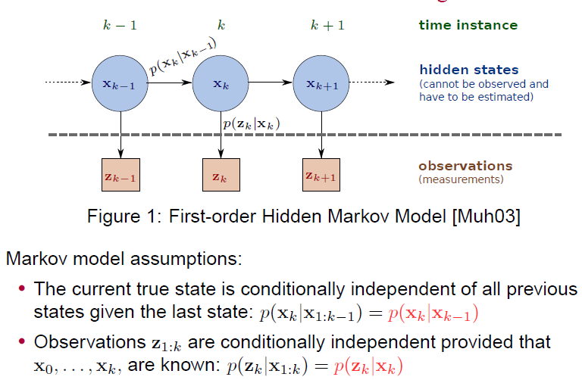
Hidden Markov Model

Slide 10

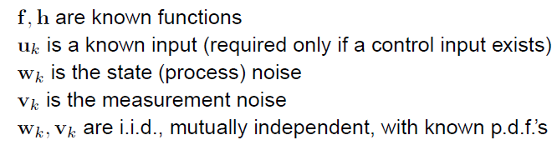
State-space Model
prediction equation: dynamic model of the system that describes the mutual dependence of the true states we would like to estimate
• measurement equation: a model for the sensor(s) that describes how observations are related to the true states

Slide 11
Bayesian Estimator
Can we do better?
The Bayesian estimator solves this problem reliably using a predict-update mechanism
Derive a formula such that the new posterior p.d.f. at time k,
is obtained by updating the old posterior at time k − 1,
.
This way, the filter can operate sequentially, in real-time (online)

Slide 12

Bayesian Estimator – Prediction Step
Assume that the old posterior is available at time k
Prediction step:
Using Chapman-Kolmogorov equation:

Slide 13

Bayesian Estimator – Update Step
Update step:
The denominator is just a normalization constant
The update combines the likelihood of the received measurement with the predicted state
The update step usually concentrates the p.d.f.

Slide 14
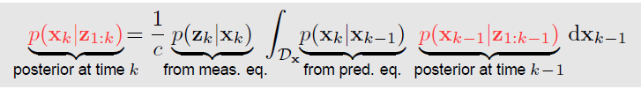
Bayesian Estimator
Predict-update equation
Sequential update of the posterior ; ;
This theoretically allows an optimal Bayesian solution – Minimum Mean Square Error (MMSE), Maximum a posteriori (MAP) estimators, etc.
Unfortunately, this is just a conceptual solution, integrals are intractable
In some cases (under restrictive assumptions), (close to) optimal
tractable solutions are obtained:
Kalman filter
Particle filter

Slide 15

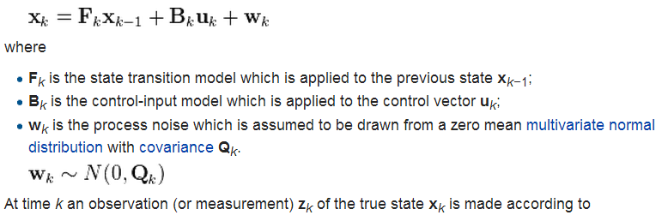
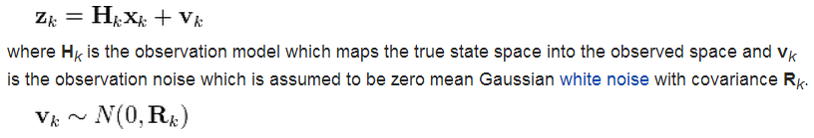
Kalman Filter

Slide 16
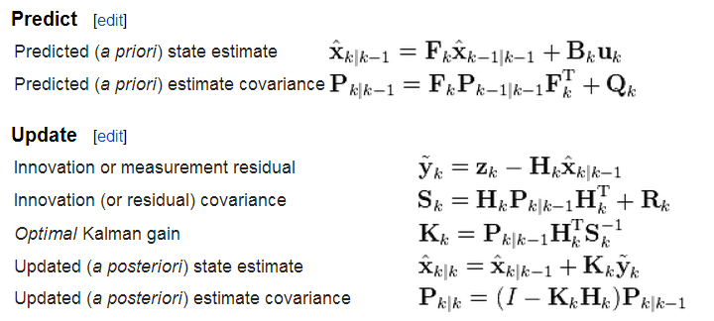
Kalman Filter - Details

Slide 17



Kalman Filter – More Details
When noises are zero-mean jointly Gaussian, Kalman filter is optimal estimator in the mean-square error (MSE) sense
It finds the posterior mean and its covariance and updates them sequentially

Slide 18
Kalman Filter Extensions (EKF, UKF)
Extended Kalman filter (EKF) – an extension of KF to non-linear state-space equations
either the process is non-linear, or the measurements are not a linear function of the states
EKF linearizes the model about the new estimate
works well in many situations, but may diverge for highly non-linear models (covariance is propagated through linearization)
Unscented Kalman filter (UKF) – mean and covariance are projected via the so-called unscented transform
picks up a minimal set of sample points around the mean – called sigma points – propagates those through the non-linearity
UKF can deal with highly-nonlinear models
often, UKF works better than EKF
KF, EKF, UKF do not work very well for p.d.f.’s that have
heavy-tails / high kurtosis
They may totally fail for heavily skewed p.d.f.’s or bimodal/multimodal p.d.f.’s
We need more general filters to tackle these problems

Slide 19
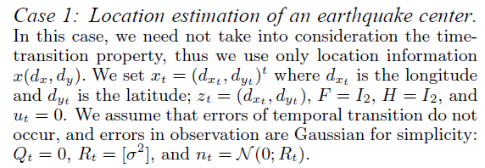
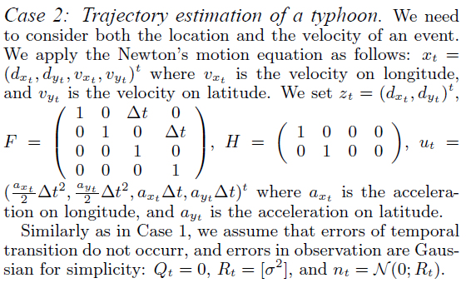
Real-world Applications

Slide 20
Result Analysis
Performances: Kalman filtering
linear Gaussian assumption does not hold for this problem.
if the center of the earthquake is in the sea area
it becomes more difficult to make good estimations in less populated
all other things being equal, the greater the number of sensors, the more precise the estimation will be.

Slide 21
Earthquake Reporting System
Earthquake detection and notification using the system
20 s before its arrival at a point that is 100 km distant.

Slide 22
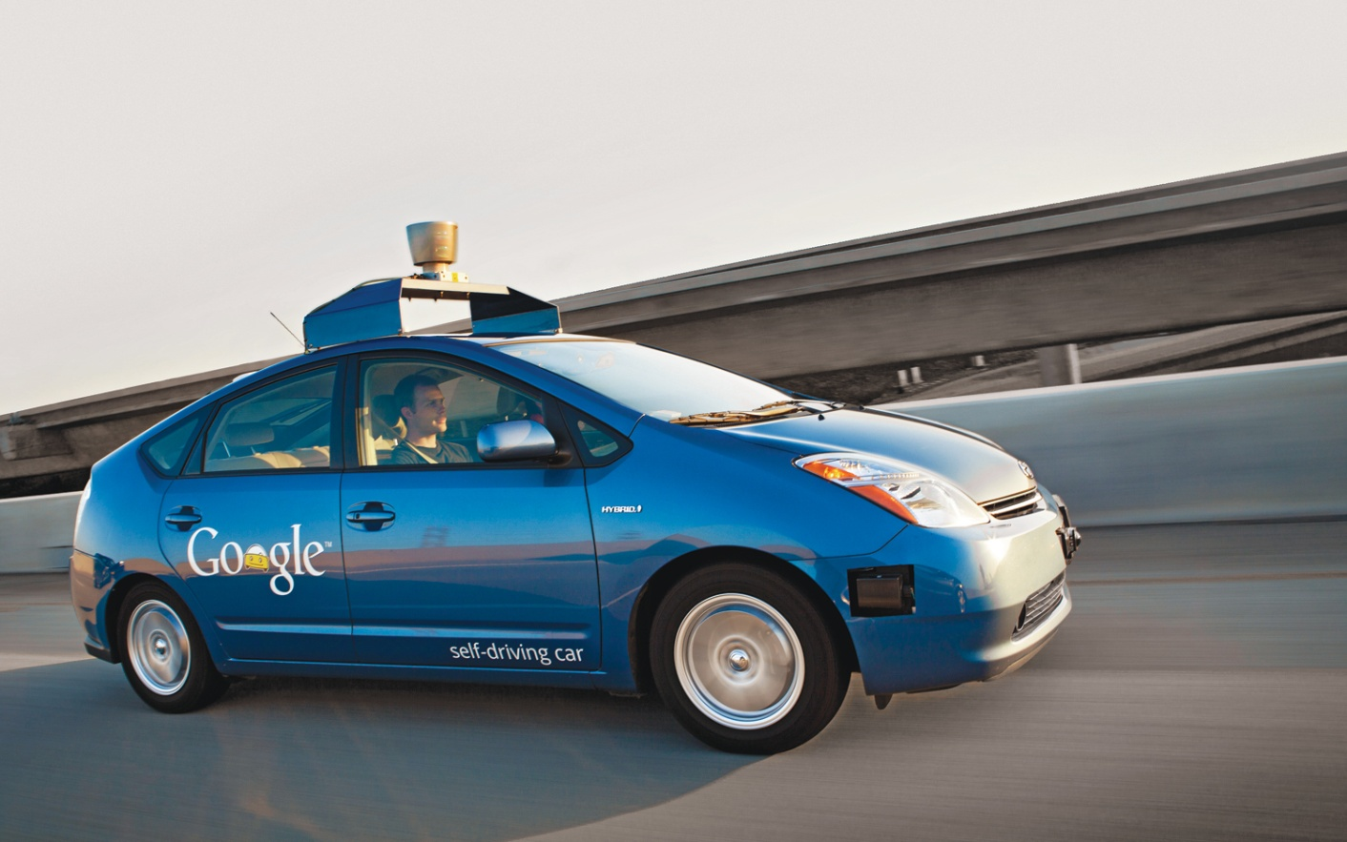
Unmanned Vehicles
https://www.youtube.com/watch?v=bp9KBrH8H04

Slide 23
Acknowledgement
Thanks for the generous help from Prof. Marco Valtorta who helps me better understand Kalman filter.

Slide 24
References:
Aruban, Traian E. (2012). Bayesian filters for locations estimation and tracking – an introduction. GETA winter
school: short course on wireless localization, Ruka.
Fox, D., et al. (2003). Bayesian filtering for location estimation. IEEE Pervasive Computing 2(3): 24-33.
Kalman, R. E. (1960). A new approach to linear filtering and prediction problems. Transaction of the ASME—Journal
of Basic Engineering, pp. 35-45.
Sakaki, T., et al. (2010). Earthquake shakes Twitter users: real-time event detection by social sensors. Proceedings of
the 19th international conference on World wide web. Raleigh, North Carolina, USA, ACM: 851-860.
Wikipedia: http://en.wikipedia.org/wiki/Kalman_filter.
Z. Chen. Bayesian Filtering: From Kalman filters to particle filters, and beyond. Adaptive Systems Lab., McMaster
Univ., Hamilton, ON, Canada [Online]. Available: http://soma.crl.mcmaster.ca/zhechen/download/ieee_bayesian.ps

Slide 25

Questions?

